Slide 1

Weighted Least
Squares
If the error terms are normally distributed but the variance of the error term is not constant, a standard remedial measure is to use weighted least squares.
When using weighted least squares, the regression model assumes that the variances are different for each error term. Thus we have that
where ε_{i} are independent N(0,σ_{i}²)
The basic idea underlying weighted least squares is that observations with smaller variances provide more information than those with larger variances so we will give more weight to observations with smaller variances.

Slide 2
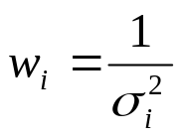
Weighted Least
Squares
The weights that are used for each observation are defined as
Thus the smaller the variance of an observation, the larger the weight.
When maximizing the likelihood function, the common term 1/σ² is no longer in the expression.
Instead, the likelihood function contains the weights, 1/σ_{i}². As such, the least squares estimators for the β’s are not the same.

Slide 3
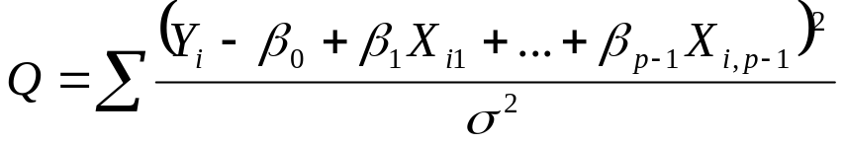
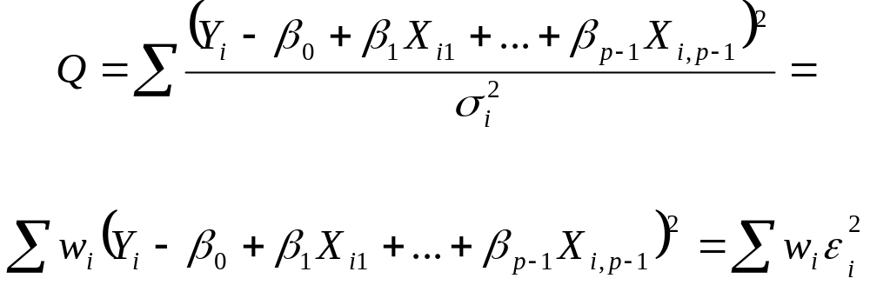
Weighted Least
Squares
As a result, instead of minimizing
which doesn’t depend on σ², we are minimizing
which does depend on the values of the σ_{i}²

Slide 4
Weighted Least
Squares
With unweighted regression, we have that
b= (X’X)⁻¹X’Y
With weighted regression, we have that
b= (X’WX)⁻¹X’ WY
where W is a matrix of the weights.
With weighted regression, the weights are also a part of the variance of b. Inference on the individual Betas is then done as usual.

Slide 5
Weighted Least
Squares
If the variances σ_{i}² were known, we could simply use the weights w_{i}. However, we typically do not know the variances.
As such, we have to estimate the variances. The first method of estimation is based on empirical findings that the magnitudes of σ_{i}² often vary in a regular fashion with one or several predictor variables or with the mean response E{Y_{i}}.
Recall the funnel shaped residuals when we were testing for constant variance.
Such a relationship can be estimated using the squared residuals e_{i}², which are estimates of σ_{i}².

Slide 6
Weighted Least
Squares
We can estimate the variance function describing the relationship between σ_{i}² to relevant predictor variables by first fitting the regression model using unweighted least squares and then regressing the squared residuals e_{i}² against the relevant predictor variables.
Alternatively, we can estimate the standard deviation function describing the relationship between σ_{i} to relevant predictor variables by using the absolute residuals |e_{i}|.
To estimate the standard deviation function, we regress the absolute residuals |e_{i}| against the relevant predictor variables.
The standard deviation function is more robust to outliers.

Slide 7
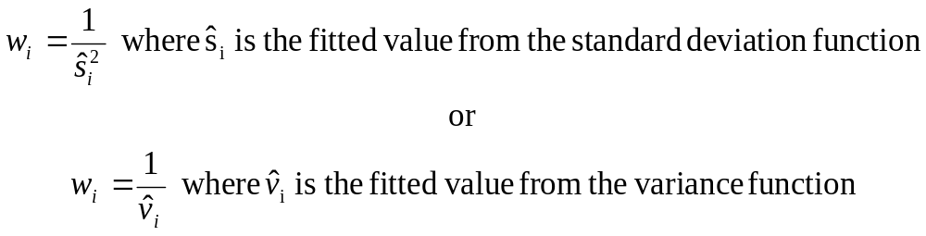
Weighted Least
Squares
For example, suppose a residual plot against X₁ exhibits a funnel shape. Then regress the absolute residuals against X₁ to estimate the standard deviation function.
After the variance or standard deviation function is estimated, the fitted values are used to estimate the weights.

Slide 8
Weighted Least
Squares
The estimated weights are then placed in the weight matrix W and the estimated regression coefficients are obtained by
b= (X’WX)⁻¹X’ WY
To summarize:
Fit the regression model by unweighted least squares and analyze the residuals
Estimate the variance or standard deviation function by regressing either the squared residuals or the absolute residuals on the appropriate predictors.

Slide 9
Weighted Least
Squares
Use the fitted values from the estimated variance or standard deviation function to obtain the weights.
Estimate the regression coefficients using these weights.
If the estimated coefficients differ substantially from the estimated coefficients by unweighted least squares, it is usually advisable to iterate the weighted least squares process by using the residuals from the weighted least squares fit to re-estimate the variance or standard deviation function and then obtain revised weights.
Often, one or two iterations are sufficient to stabilize the estimated coefficients. This iteration process is called iteratively re-weighted least squares.

Slide 10
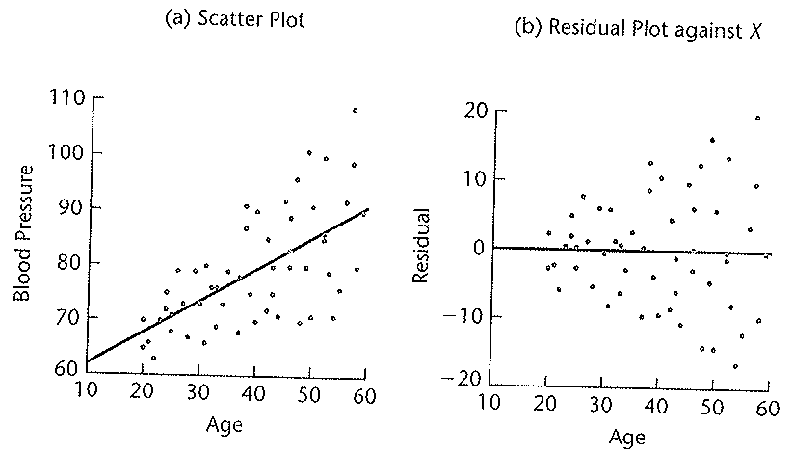
Weighted Least
Squares
A health researcher, interested in studying the relationship between blood pressure and age collected data on 54 subjects. The scatter plot of the data suggests a linear relationship between blood pressure and age. However, plotting the residuals against age indicates that the error terms increase with age.

Slide 11

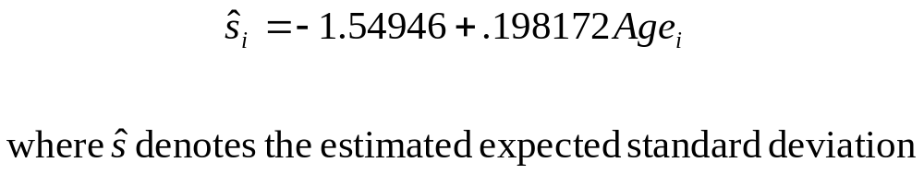
Weighted Least
Squares
The researcher fitted a linear regression using unweighted least squares. The regression function was
The standard deviations of b₀ and b₁ were 3.994 and .09695, respectively.
Based on the plots, the researcher then regressed the absolute residuals against age and obtained

Slide 12
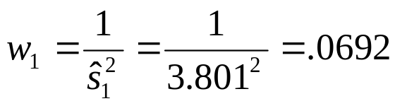
Weighted Least
Squares
To obtain the weights, the researcher obtained the fitted values from the standard deviation function. For example, for case 1, X=27 and the fitted value is
The weights are then obtained. For example

Slide 13
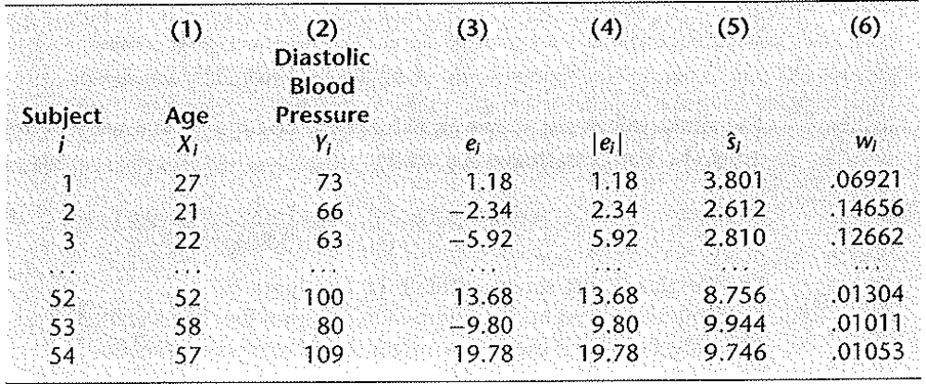

Weighted Least
Squares
The estimated standard deviations, that is the fitted values, and the weights are shown in the table below.
Using these weights in a regression program that has weighted least squares capability, the researcher obtained the regression function

Slide 14

Weighted Least
Squares
Note, the estimated regression coefficients are not much different than when unweighted least squares was used.
Unweighted least squares:
Weighted least squares:
However, the standard deviation of b₁ using weighted least squares is .07924, while it was .09695 using unweighted least squares, a reduction of about 18%.
SAS: weighted

